Slide 1

Toxic Comment Classification
Identify and Classify Toxic Online Comments
-:Team:-
Krishna Bhavsar
Milind Joshi
Parvez Khan

Slide 2
TOC - Machine Learning Based Approach
Problem Statement
Data Description
Literature Review
Basic Exploratory Data Analysis
Kaggle Submission
Feature Engineering and Model Selection
Future Direction’s

Slide 3
Problem Statement
Social media platforms provide an environment where people can freely engage in discussions. Unfortunately, they also enable several problems, such as online harassment.Recently, Google and Jigsaw started a project called Perspective, which uses machine learning to automatically detect toxic language.
A demonstration website has been also launched https://www.perspectiveapi.com/ which allows anyone to type a phrase in the interface and instantaneously see the toxicity score.

Slide 4
DataSet Description
Competition data set is available at Kaggle. A large number of Wikipedia comments are provided which have been labeled by human raters for toxic behavior. The problem has only one predictor variable, 'comment_text', which is to be labeled or classified with respect to six target variables
The target variable are the following types of toxicity:
Toxic
severe toxic
Obscene
Threat
Insult
identity hate
Aim : To create a model which predicts a probability of each type of toxicity for each comment.

Slide 5
Literature Review
So far, Jigsaw and Google have built a range of publicly available models served through the Perspective API, including toxicity.
But the current models still make errors like Susceptibility to false alarm, Robustness to random misspellings as mention in their research paper.
Through this competition, they have proposed a challenge to build a multi-headed (multi-labeled) model that is capable of detecting different types of toxicity, as mentioned above.

Slide 6
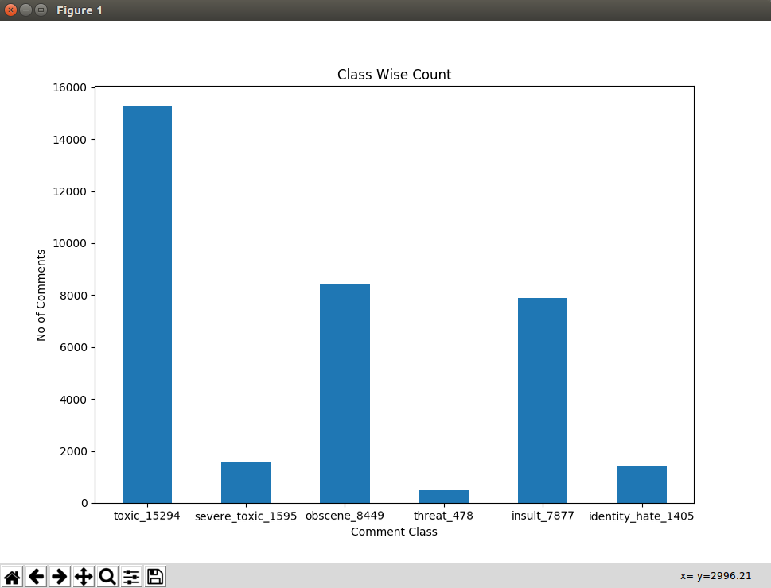
Basic Exploratory Data Analysis

Slide 7
Feature Engineering and Model Selection
Data Preprocessing
Python scikit-learn can deal with numerical data only.
TF-IDF Vectorizer , CountVectorizer and Gensim Word2Vec
Logistic Regression
Multinomial Naive Bayes.

Slide 8
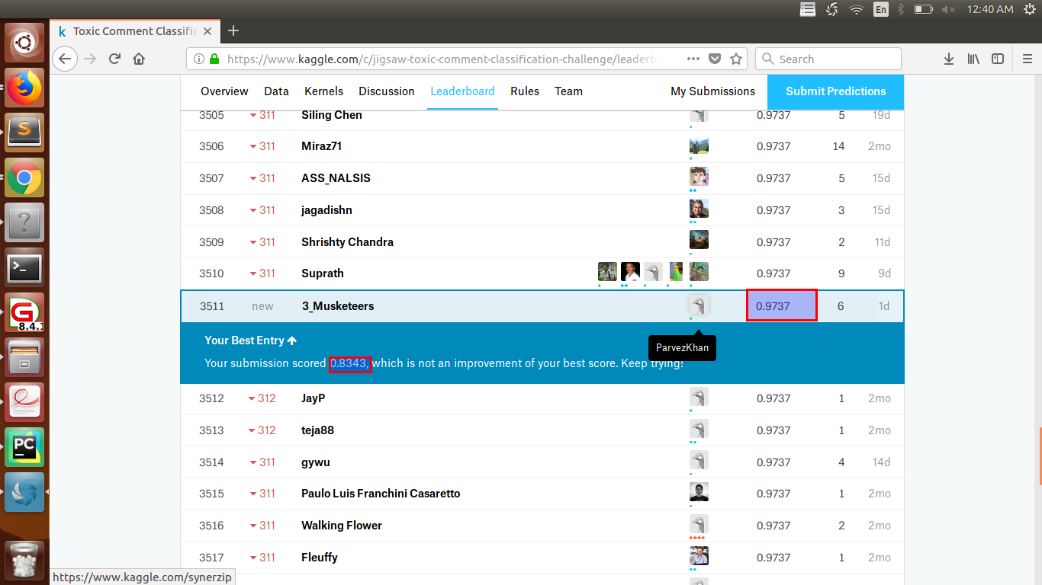
Kaggle Submission

Slide 9
Rule Based Approach
Method that identifies, learns and evolves ‘rule’ to store, manipulate or apply.
Characteristics of rule based approach is identification and utilization of a set relational rules that collectively represents the knowledge captured by the system.

Slide 10
Rule Based Approach
In accordance with the rule based approach, to rule out all the toxic comment things we decided to go with.
For this we considered all the comments which are marked as Toxic Comments.
We tokenized every word from each comment.
We separated all the toxic words from the comments in the given database.
Built toxic word_dictionary with all the toxic words

Slide 11
Conclusion
Standard Machine Learning (ML) algorithms yielded a maximum score of 0.97, irrespective of any approach.
In order to improve the score further, one has to employ Deep Learning (DL) techniques.

Slide 12
Future Plan
Analyze the problem by employing Deep Learning techniques and model the problem using
Recurrent Neural Networks (RNN)
Convolutional Neural Networks (CNN)
LSTM
In order to improve the score further, one has to employ Deep Learning (DL) techniques.

Slide 13
Thank You..!

